Slide 1
NCODA’s 2026 Fall Summit Poster Guidelines & Submission Handbook

Slide 2
NCODA’s 2026 International Fall Summit
Dates: Oct 28-30, 2026
Location: Orlando World Center Mariott
Address: 8701 World Center Dr, Orlando, FL 32821
Overview: The NCODA Fall Summit offers oncology professionals an opportunity to engage with industry experts through educational sessions focused on patient-centered care and medically integrated oncology. The event includes an exhibit hall showcasing innovative products and services aimed at enhancing oncology practices and patient care.
NCODA members residing in North America with an accepted abstract will receive complimentary registration, travel, and hotel for one presenter to support their day-of poster presentation. Must arrive on 10/28 and depart on 10/30.
Partners: Complimentary registration, airfare, and hotel are NCODA poster presentation membership benefits, and your enrollment will be coordinated through partner registration.

Slide 3
Poster Timeline
Date | Milestone
Mon, June 1 | Abstract submission period begins
Fri, July 10 | Abstract(s) submissions deadline
Fri, July 24 | Abstract acceptance/denial and feedback delivered
Fri, July 31 | Final abstract(s) resubmission deadline
TBD | 2026 Fall Summit Registration Opens
Mon, Aug 3 | Poster(s) submission period begins
Fri, Aug 28 | Poster(s) submission deadline
Fri, Sept 11 | Poster acceptance/denial and feedback delivered
Fri, Sept 18 | Final poster(s) resubmission deadline
Fri, Sept 25 | Schedule for poster showcase delivered
Oct 28-30 | Fall Summit
Thu, Oct 29 | Fall Summit Poster Sessions Day 1
Fri, Oct 30 | Fall Summit Poster Sessions Day 2

Slide 4
Poster Timeline – Calendar View
June 2026
Monday | Tuesday | Wednesday | Thursday | Friday
1 | 2 | 3 | 4 | 5
Abstract Submission Opens
8 | 9 | 10 | 11 | 12
15 | 16 | 17 | 18 | 19
 |  |  |  | Juneteenth
22 | 23 | 24 | 25 | 26
29 | 30
July 2026
Monday | Tuesday | Wednesday | Thursday | Friday
 |  | 1 | 2 | 3
 |  |  |  | Independence Day (Observed)
6 | 7 | 8 | 9 | 10
 |  |  |  | Abstract Deadline
13 | 14 | 15 | 16 | 17
20 | 21 | 22 | 23 | 24
 |  |  |  | Abstract Acceptance/Denial & Feedback Delivered
27 | 28 | 29 | 30 | 31
 |  |  |  | Final Abstract Resubmission

Slide 5
Poster Timeline – Calendar View
August 2026
Monday | Tuesday | Wednesday | Thursday | Friday
3 | 4 | 5 | 6 | 7
Poster Submission Opens
10 | 11 | 12 | 13 | 14
17 | 18 | 19 | 20 | 21
24 | 25 | 26 | 27 | 28
 |  |  |  | Poster Deadline
31
September 2026
Monday | Tuesday | Wednesday | Thursday | Friday
 | 1 | 2 | 3 | 4
7 | 8 | 9 | 10 | 11
Labor Day |  |  |  | Poster Acceptance/Denial & Feedback Delivered
14 | 15 | 16 | 17 | 18
 |  |  |  | Final Poster Resubmission
21 | 22 | 23 | 24 | 25
 |  |  |  | Poster Schedule Delivered
28 | 29 | 30

Slide 6
Poster Timeline – Calendar View
October 2026
Monday | Tuesday | Wednesday | Thursday | Friday
 |  |  | 1 | 2
5 | 6 | 7 | 8 | 9
12 | 13 | 14 | 15 | 16
Indigenous People's Day
19 | 20 | 21 | 22 | 23
26 | 27 | 28 | 29 | 30
 |  | FALL SUMMIT | FALL SUMMIT | FALL SUMMIT

Slide 7
(III) Hot Topic
(IV) Original Research
(V) Review
Service of Program/Background
Justification/Documentation
Adaptability
Significance
Introduction/Background
Research Question/Hypothesis
Study Design
Methods
Results
Conclusions
Introduction/Background
Methods
Results/Primary Study Points
Discussion
Other
Conclusion
(I) Case Report
Introduction/Background
Case
Discussion
Conclusion
(II) Education/Training
Introduction/Background
Clinical Significance/Service
Justification/Documentation
Adaptability
Significance
Abstract Requirements
NCODA Poster Abstract
2026 Fall Summit
The Main Topic (e.g., Case Reports)
Name and Credentials | Institution, Organization, or University
Email
Header
Title [≤25 words]
Learning Objectives [≤75 words]
Abstract [≤500 words]
Choose One Main Topic Below:
Case Report
Education/Training
Hot Topic
Original Research
Review
References
Body
Your abstract should be labeled under one of the main topics (e.g., III – Hot Topic), but you may adjust the suggested subtitles (e.g., Service of Program/Background) to best suit your content. These subtitles should guide your writing and your abstract itself should be submitted in this structured format. Please note that tables and charts cannot be accommodated within abstracts.

Slide 8
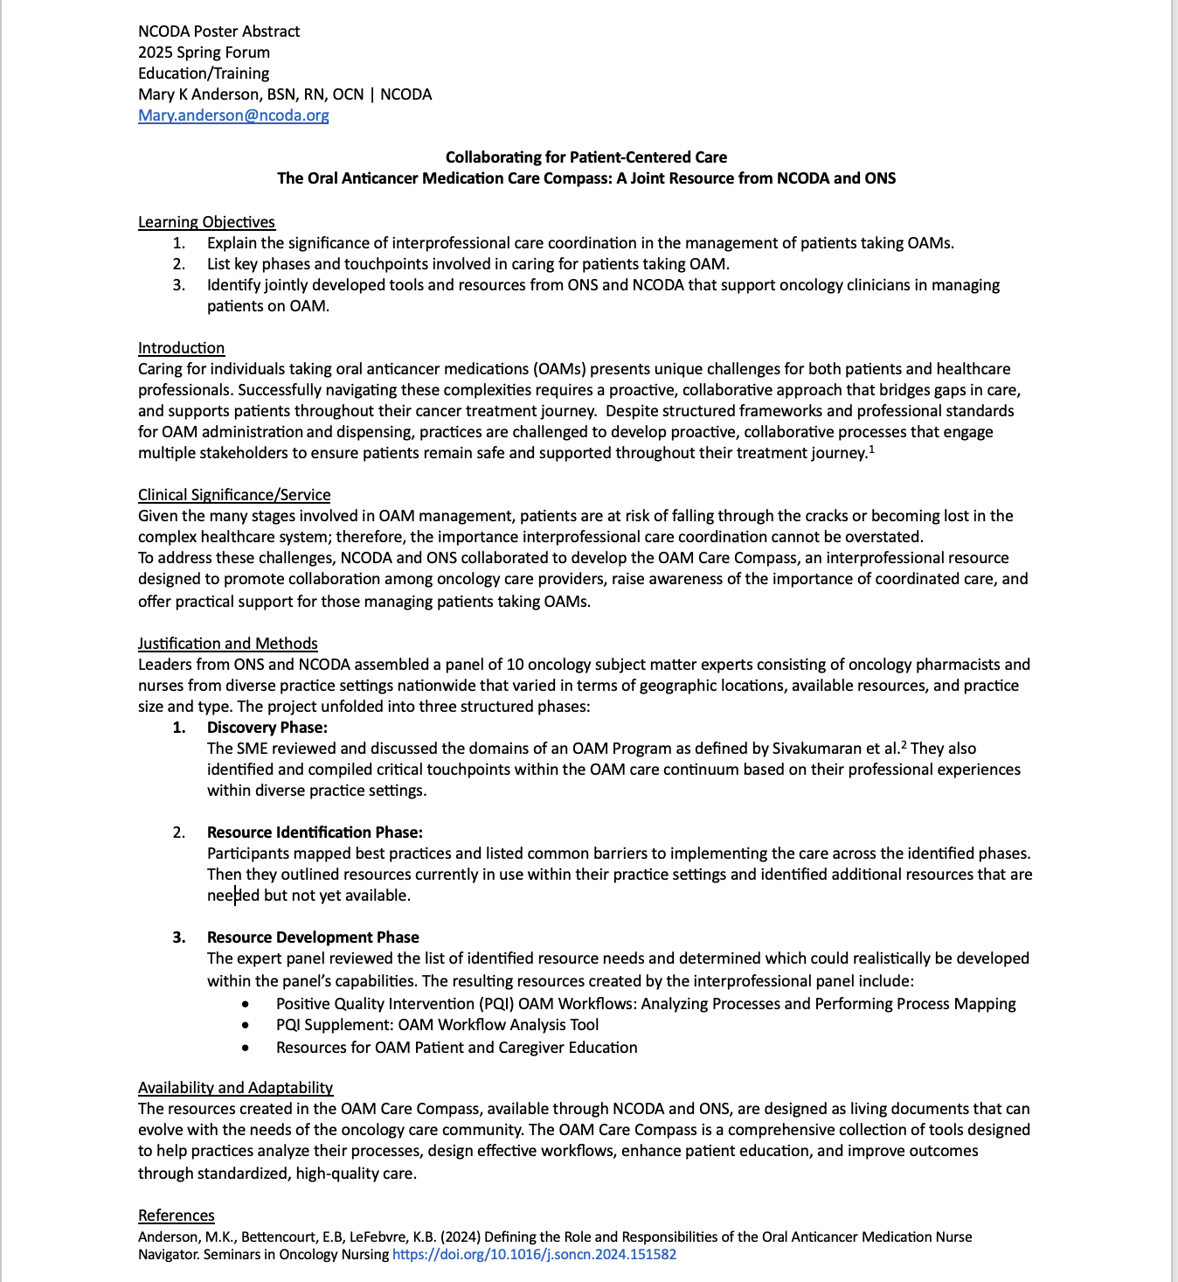

Abstract Example #1

Slide 9
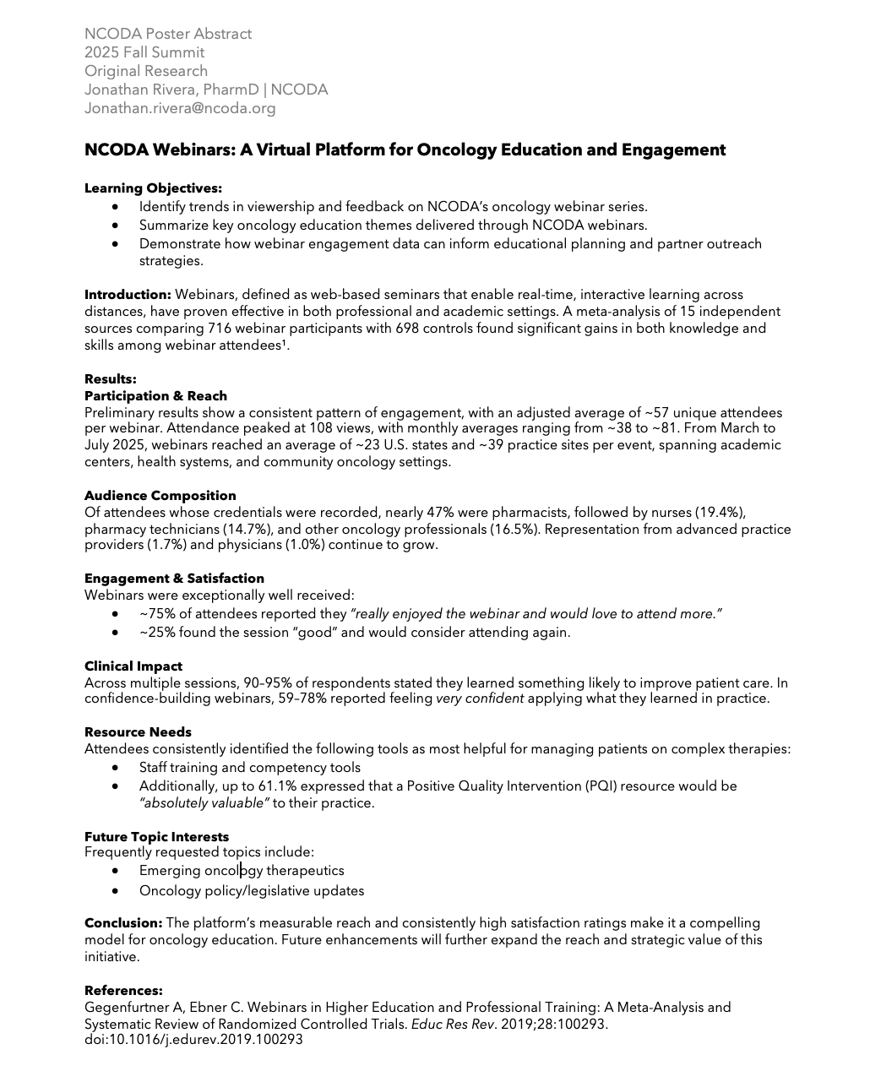
Abstract Example #2

Slide 10
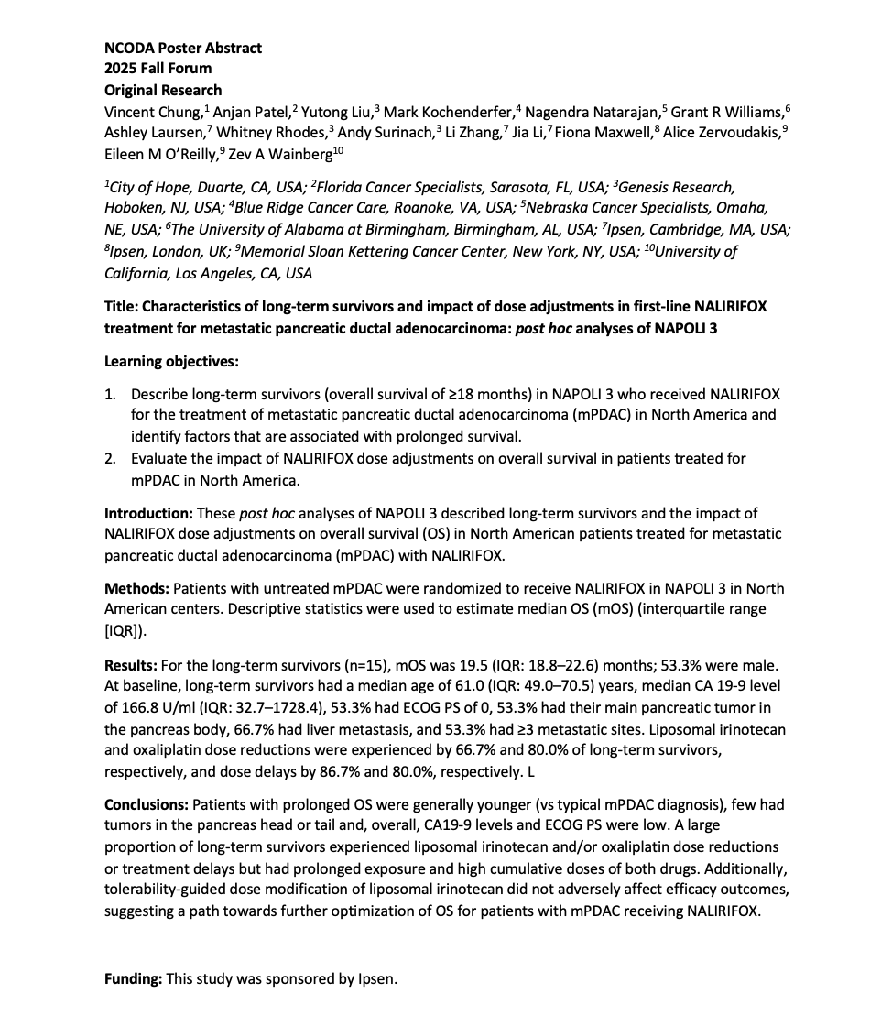
Abstract Example #3

Slide 11
Abstract Submission Instructions
Complete your abstract and save it as an editable Word document (.doc or .docx)
Email the abstract with the subject line:
2026 Fall Summit Abstract – [Poster Title]
Send to: posterpresentations@ncoda.org
CC: your designated committee lead
If you are an NCODA member, please specify in the body of your email the full name and email address of the presenter you wish to assign complimentary registration to. If a partner, please disregard this request.
Deadline: Fri, July 10
Committee Lead Contacts (CC the appropriate one):
Submitter Role | Committee Lead
Physicians & Advanced Practice Providers | Corinne.Shamehdi@ncoda.org
Pharmacists | Natasha.Olson@ncoda.org
Nurses | Mary.Anderson@ncoda.org
Pharmacy Technicians | Taryn.Newsome@ncoda.org
Residents & Students | Mustafa.Abacioglu@ncoda.org
Industry Partners & Fellows | Jonathan.Rivera@ncoda.org
Research Focused (PhD, MS, MA) | Brian.Sturgeon@ncoda.org

Slide 12
Additional Abstract Information & Next Steps
You will receive feedback by Fri, July 24
After revisions, submit your finalized abstract via email to posterpresentations@ncoda.org and CC you designated email lead.
An approved finalized abstract submission is required for your poster to be accepted and featured at the Fall Summit.
If abstract feedback is provided, your final revised submission is due by Fri, July 31
Email the abstract with the subject line:
2026 Fall Summit Abstract – [Poster Title]
Send to: posterpresentations@ncoda.org
CC: your designated committee lead
Begin working on your poster using the approved abstract edits.

Slide 13
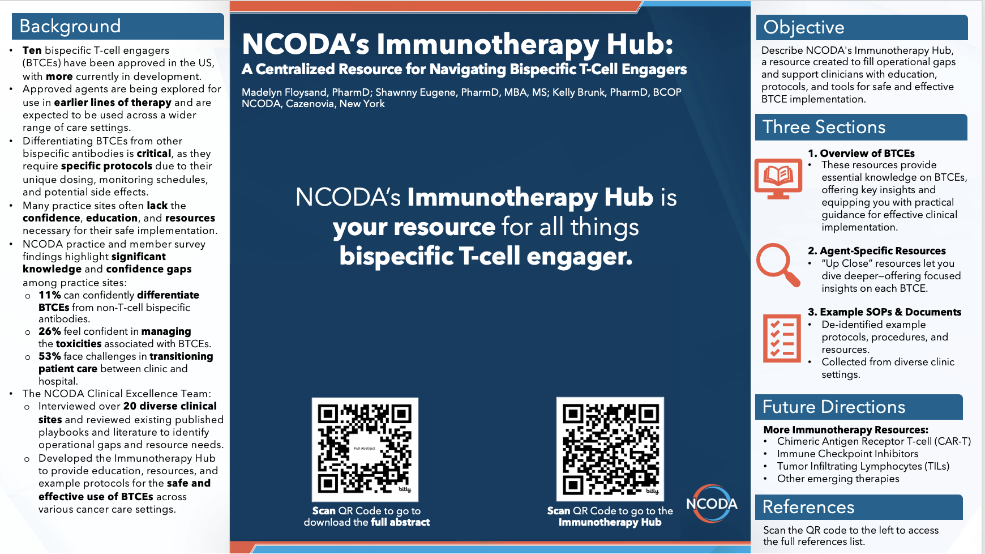
Poster Example #1

Slide 14

Poster Example #2

Slide 15
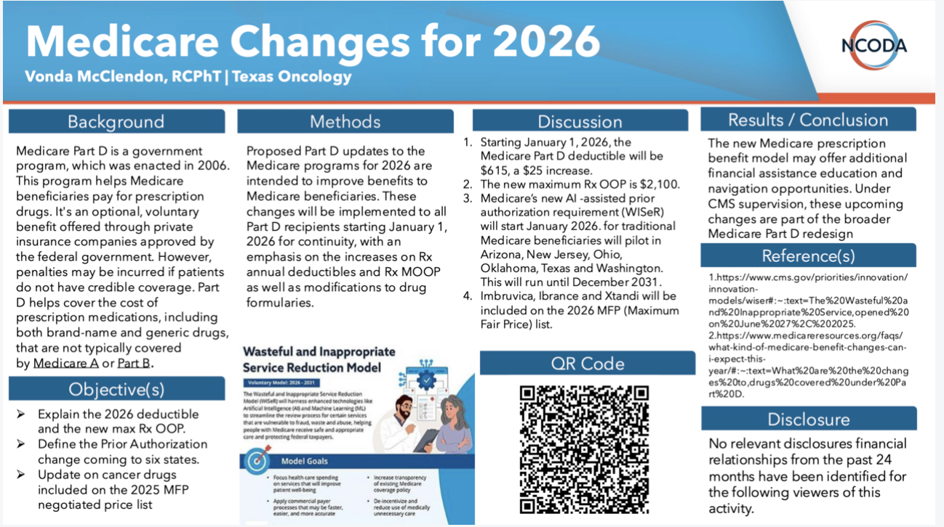
Poster Example #3

Slide 16
Poster Submission
You can submit your poster by filling out the survey “Fall Summit Poster Submission” found in this link
The poster submission link will open on Mon, Aug 1
Please submit your poster by Fri, Aug 28
If accepted, you may receive feedback on your poster by Fri, Sept 11
After completing your requested revisions, please submit your finalized poster via email to posterpresentations@ncoda.org and CC you designated email lead by Fri, Sept 18. There is no need to resubmit via the survey.
You will receive the 2026 Fall Summit poster schedule by Fri, Sept 25

Slide 17
Poster Submission Alternative
If you are unable to submit your poster via Google Forms, you may email it as a PowerPoint (.pptx) or PDF (16:9 ratio, 1920x1080 px, 300 dpi)
Email the poster with the subject line:
2026 Fall Summit Poster – [Poster Title]
Send to: posterpresentations@ncoda.org
CC: your designated committee lead
Deadline: Fri, Aug 28
Include the following information in your email:
Your name (First Name Last Name) and associated credentials (if applicable):
Preferred contact email for the person submitting the poster(s):
Poster presenter(s) name(s) (First Name Last Name) and associated credentials (if applicable):
Poster presenter(s) preferred contact email:
Poster presenter(s) affiliated institution/organization/university:
Names and emails of individuals to include on NCODA poster communications (other than the person submitting or the presenter(s)). List names and emails. If not applicable, type "N/A":
Poster title (exactly as it appears on the poster):
Poster category (select one): (Case Report, Education/Training, Hot Topic, Original Research, Review):
Consent for use of abstract and poster in event materials and online: (Yes/No)
Are any of the posters being submitted a Trial-in-Progress (TIP) or Encore. If yes, include the poster titles and identify whether each is a TIP or encore. If not applicable, type "N/A":
Special requests or accommodations needed. If not applicable, type “N/A”:

Slide 18
Poster Reminders
Technical & Design Specifications
Poster Size: PowerPoint or PDF (16:9 ratio, 1920x1080 px, 300 dpi).
Display: Posters will be shown on a 65" TV screen.
Font Size: Minimum 10-14 pt font.
Font Style: Stick to serif or sans-serif fonts (e.g., Arial, Calibri, Times New Roman).
Graphics & Images:
Use high-resolution images. Avoid blurry, pixelated, or stretched graphics.
Ensure graphs, charts, and visuals are labeled clearly (e.g., axes, legends, units).
Use text overlays on shapes instead of typing directly into shapes to maintain consistent font size.
No audio, video, or animations allowed.
Alignment & Spacing:
Maintain consistent alignment across all elements. Misalignments are especially noticeable on the large displays.
Ensure consistent font sizes and styles throughout.
Color Scheme: Use a professional, high contrast color palette to maximize readability.

Slide 19
Poster Reminders
Content & Presentation Best Practices
Title:
Avoid starting with "A," "An," or "The".
If applicable, do not include brand names in the title.
Acronyms: Always spell out acronyms on the first use (e.g., over-the-counter (OTC)).
References:
Use American Medical Association (AMA) style for all references, including images.
If space is limited, you may include a QR code linking to full references or additional materials. Please ensure the QR code works properly and is not set to expire.
Visual Cues: Consider using callout boxes or arrows to highlight key points or data.
Language:
Maintain a professional tone throughout.
Ensure spelling and grammar are correct. Proofread carefully.
Presenter Preparation
Elevator Speech: Prepare a 3-4-minute summary of your poster for the presentation session.
Practice presenting your poster verbally to ensure clarity and confidence.
Dress Code Reminder: Business professional attire is expected for the presentation.

Slide 20
Frequently Asked Questions
Is there a submission fee?
No. There is no fee to submit your poster.
Do you accept Trial-in-Progress (TIP) or Encore posters?
Yes, with conditions. NCODA currently accepts TIP and Encore Posters:
Be identified as such during abstract and poster submission.
Include in the disclaimer that the poster is a TIP or an Encore poster.
Please note:
Priority approval will be given to posters that are not TIPs or Encores, as spots are limited.
If space permits, TIPs and Encores will be considered without issue.
Are submitted posters peer reviewed?
Yes. All posters and abstracts undergo peer review by the NCODA Poster Committee.
If the first author is not able to attend the congress to present in person who may present on their behalf?
A co-author may present on behalf of the first author.
If a pharmaceutical company employee will present on behalf, please inform us of their name and company during submission.
The designated presenter must be registered for the 2026 Fall Summit.
Do I need to prepare a printed version of the poster?
No. Posters will be displayed on a 65" TV screen during the presentation. A printed version is not required.
Am I required to use the NCODA poster template?
No. The NCODA poster template is not required. It is simply provided as a resource to help you get started. If you have an existing company or organization poster, you are welcome to use your own template.
Are posters published anywhere?
Posters and abstract will be published:
On the NCODA website
In Summit Rewind or Forum Rewind (Only for their respective conference)
In the NCODA Journal of Oncology Abstracts (NJOA)

Slide 21
Support & Contacts
For questions or assistance, please contact: posterpresentations@ncoda.org
CC: your poster committee lead
We're happy to assist with any questions regarding abstract/poster submissions, formatting, deadlines, or logistics!
Committee Lead Contacts (CC the appropriate one):
Submitter Role | Committee Lead
Physicians & Advanced Practice Providers | Corinne.Shamehdi@ncoda.org
Pharmacists | Natasha.Olson@ncoda.org
Nurses | Mary.Anderson@ncoda.org
Pharmacy Technicians | Taryn.Newsome@ncoda.org
Residents & Students | Mustafa.Abacioglu@ncoda.org
Industry Partners & Fellows | Jonathan.Rivera@ncoda.org
Research Focused (PhD, MS, MA) | Brian.Sturgeon@ncoda.org

Slide 22
Poster Templates

Slide 23
Title
Name(s) | Name of Organization
Background
Methods
Discussion
Results / Conclusion
State the purpose of the research and summarize the current knowledge, the knowledge gap, and how the research project proposes to address the knowledge gap.
Describe the approach, including study design, participants, data collection, and analysis methods.
Interpret the results, highlighting their significance, implications, and potential limitations.
Summarize the key findings of the project or research, often with the support of data tables or figures.
REPLACE WITH GRAPHICS: (charts, graphs, diagrams, etc.) that effectively convey the data or concepts.
Reference(s)
Ensure all literature, data, prior work, graphics, etc., referenced in the presentation are properly cited.
Objective(s)
Disclosure
Identify the specific aims or research questions the project seeks to answer.
Disclose all financial or personal relationships that could influence the research or outcomes.

Slide 24
Title
Name(s) | Name of Organization
Background
Methods
Discussion
Results / Conclusion
State the purpose of the research and summarize the current knowledge, the knowledge gap, and how the research project proposes to address the knowledge gap.
Describe the approach, including study design, participants, data collection, and analysis methods.
Interpret the results, highlighting their significance, implications, and potential limitations.
Summarize the key findings of the project or research, often with the support of data tables or figures.
Objective(s)
REPLACE WITH GRAPHICS: (charts, graphs, diagrams, etc.) that effectively convey the data or concepts.
Reference(s)
Identify the specific aims or research questions the project seeks to answer.
Ensure all literature, data, prior work, graphics, etc., referenced in the presentation are properly cited.
Disclosure
Disclose all financial or personal relationships that could influence the research or outcomes.

Slide 25
Title
Name(s) | Name of Organization
Background
Methods
Discussion
Results / Conclusion
State the purpose of the research and summarize the current knowledge, the knowledge gap, and how the research project proposes to address the knowledge gap.
Describe the approach, including study design, participants, data collection, and analysis methods.
Interpret the results, highlighting their significance, implications, and potential limitations.
Summarize the key findings of the project or research, often with the support of data tables or figures.
Objective(s)
REPLACE WITH GRAPHICS: (charts, graphs, diagrams, etc.) that effectively convey the data or concepts.
Reference(s)
Identify the specific aims or research questions the project seeks to answer.
Ensure all literature, data, prior work, graphics, etc., referenced in the presentation are properly cited.
Disclosure
Disclose all financial or personal relationships that could influence the research or outcomes.

Slide 26
Title
Name(s) | Name of Organization
Background
Methods
Discussion
Results / Conclusion
State the purpose of the research and summarize the current knowledge, the knowledge gap, and how the research project proposes to address the knowledge gap.
Describe the approach, including study design, participants, data collection, and analysis methods.
Interpret the results, highlighting their significance, implications, and potential limitations.
Summarize the key findings of the project or research, often with the support of data tables or figures.
Objective(s)
REPLACE WITH GRAPHICS: (charts, graphs, diagrams, etc.) that effectively convey the data or concepts.
Identify the specific aims or research questions the project seeks to answer.
Reference(s)
Ensure all literature, data, prior work, graphics, etc., referenced in the presentation are properly cited.
Disclosure
Disclose all financial or personal relationships that could influence the research or outcomes.

Slide 27
Title
Name(s) | Name of Organization
Background
Methods
Discussion
Results / Conclusion
State the purpose of the research and summarize the current knowledge, the knowledge gap, and how the research project proposes to address the knowledge gap.
Describe the approach, including study design, participants, data collection, and analysis methods.
Interpret the results, highlighting their significance, implications, and potential limitations.
Summarize the key findings of the project or research, often with the support of data tables or figures.
Reference(s)
Ensure all literature, data, prior work, graphics, etc., referenced in the presentation are properly cited.
Objective(s)
REPLACE WITH GRAPHICS: (charts, graphs, diagrams, etc.) that effectively convey the data or concepts.
QR Code
Identify the specific aims or research questions the project seeks to answer.
REPLACE WITH QR CODE TO LINK SUPPLEMENTAL MATERIAL
Disclosure
Disclose all financial or personal relationships that could influence the research or outcomes.

Slide 28
Background
Results / Conclusion
State the purpose of the research and summarize the current knowledge, the knowledge gap, and how the research project proposes to address the knowledge gap.
Summarize the key findings of the project or research, often with the support of data tables or figures.
Title
Name(s) | Name of Organization
Insert main finding here, emphasizing the key points.
Objective(s)
Reference(s)
Identify the specific aims or research questions the project seeks to answer.
Ensure all literature, data, prior work, graphics, etc., referenced in the presentation are properly cited.
Methods
Describe the approach, including study design, participants, data collection, and analysis methods.
Disclosure
Disclose all financial or personal relationships that could influence the research or outcomes.
REPLACE WITH QR CODE
Discussion
Interpret the results, highlighting their significance, implications, and potential limitations.

